Slide 1

INTRODUCTION TO AI
NURUL JAPAR, PhD
Department of Artificial Intelligence,
Faculty of Computer Science and Information Technology,
Universiti Malaya
nuruljapar@um.edu.my
Materials: https://github.com/shiernee/2023_AI_Workshop

Slide 2
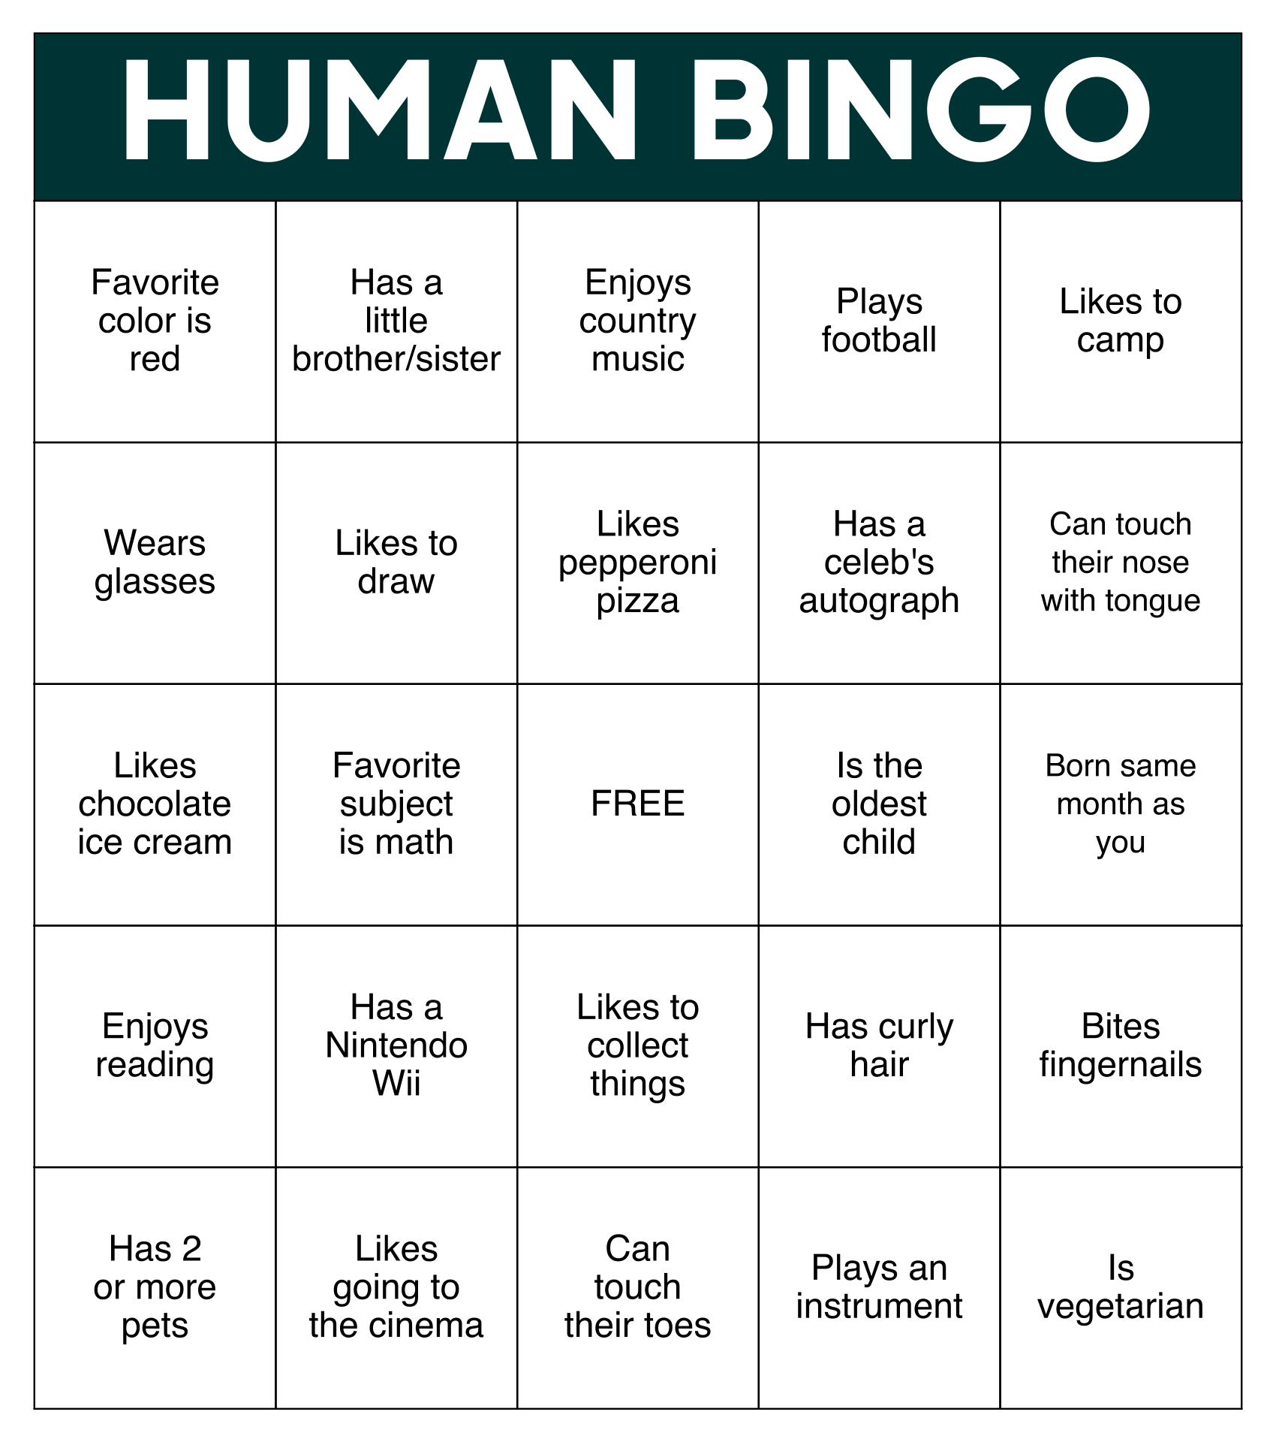
Ice Breaker
You need to MINGLE and FIND individuals who match the characteristics in the squares.
If matches a particular square, that person can sign or initial the corresponding square.
The first person to fill an entire row, column, or diagonal with matching signatures shouts "Bingo!" and wins the game.
COMPLETE IT IN 5 MINS!

Slide 3
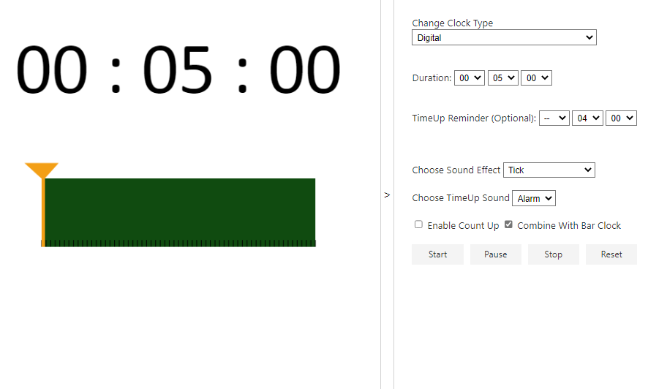

Slide 4
Debrief
Get to know each other
Based on characteristics, find similarities.
Notes:
Based on this ice breaker, the main is to get to know each other, based on CHARACTERISTICS, find SIMILARITIES. Even in this simple game, characteristics are essential to be explored, where you have to mingle, and we need to find the similarities in order to win this game. Same for machine learning tasks that we are going to learn today, characteristics and similarities will play a vital role to perform several tasks.

Slide 5
Content
Introduction to Machine Learning
Classification
Concept
Introduction to Collab
Hands on coding - classification
Regression
Concept
Hands on coding - Regression

Slide 6
Learning Outcome
By the end of this session, you will be able to
Define classification and regression task.
State four essential machine learning process.
Develop at least one AI model for classification or regression.

Slide 7
Machine Learning
Artificial Intelligence
A technique which enables machines to mimic human behaviour
Artificial Intelligence
Machine Learning
Machine Learning
Subset of AI technique which uses statistical methods to enable machines to improve with experience.
Deep Learning
Deep Learning
Subset of Machine Learning which make the computation of multi-layer neural network feasible
Notes:
I believe AI is quite a famous and common word right now. We keep hearing about Artificial intelligence, Machine learning and deep learning. What are those? AI is a technique which enables machines to mimic human behavior. Machine learning is a subset of AI in which it uses statistical methods to improve with experience. Random Forest, Support vector machine and clustering are some examples of machine learning. Deep learning, on the other hand, is more specialized in which the computation is designed in a multi-layered neural network architecture.

Slide 8
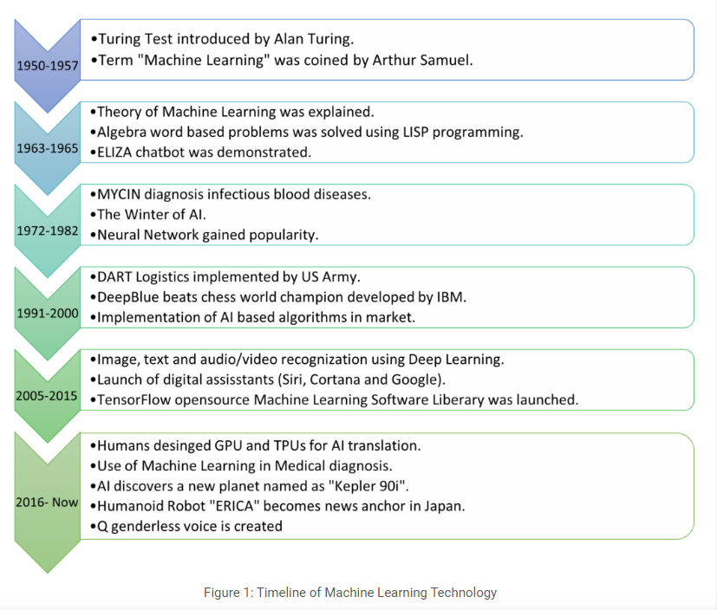
History
Source: https://insights2techinfo.com/future-scope-of-machine-learning-and-ai-in-2022/

Slide 9
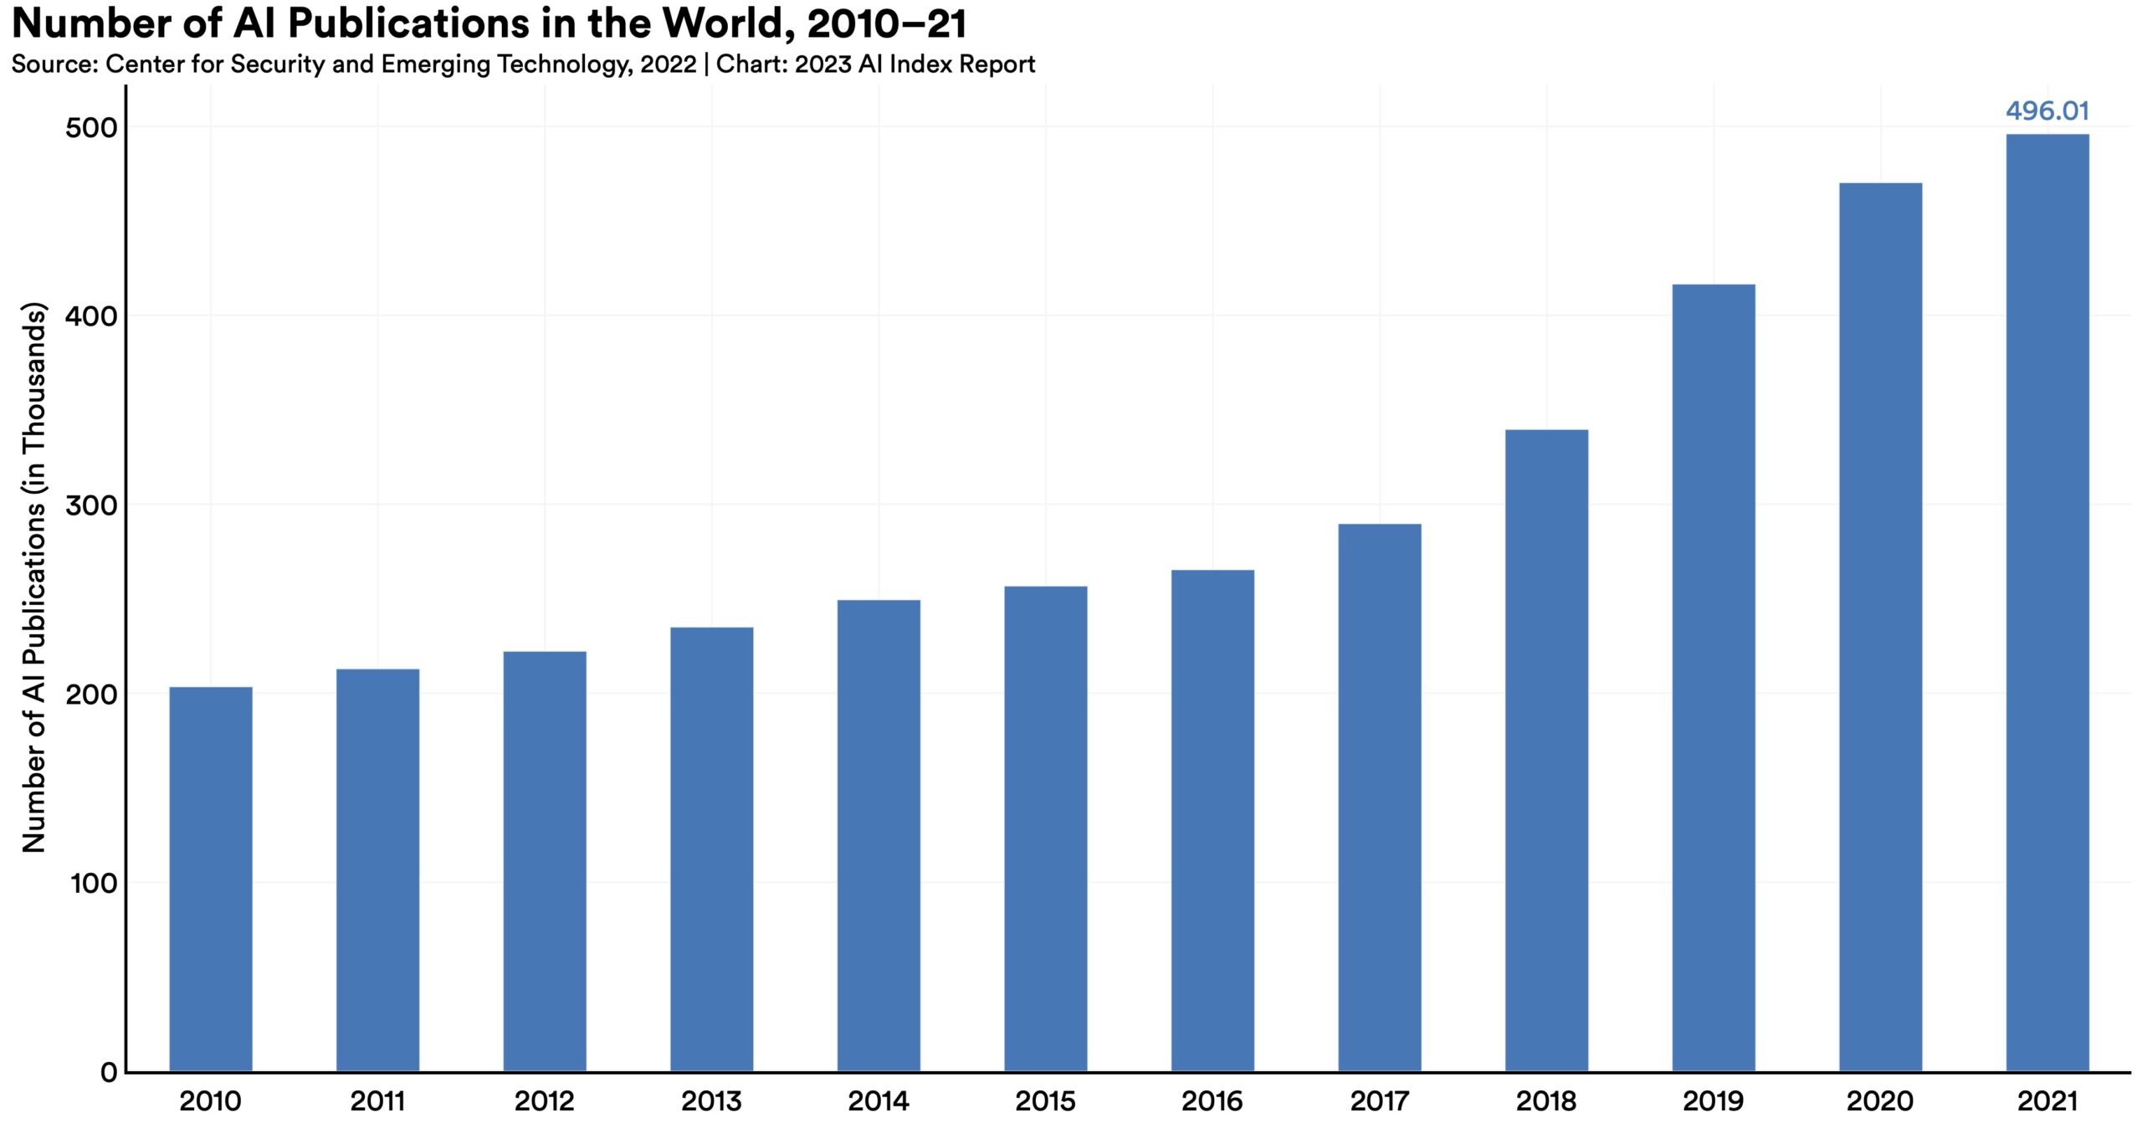
No. AI Publication from Stanford University HAI
The total number of AI publications has more than doubled since 2010. The specific AI topics that continue to dominate research include pattern recognition, machine learning, and computer vision.
Source: https://aiindex.stanford.edu/report/

Slide 10
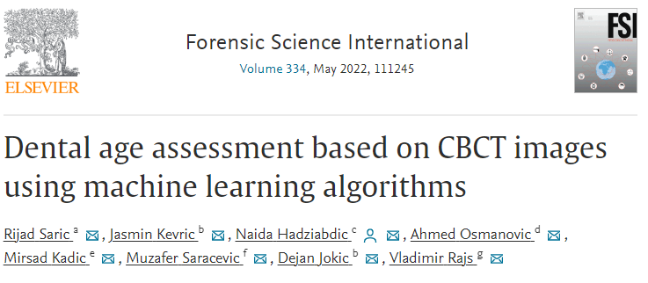
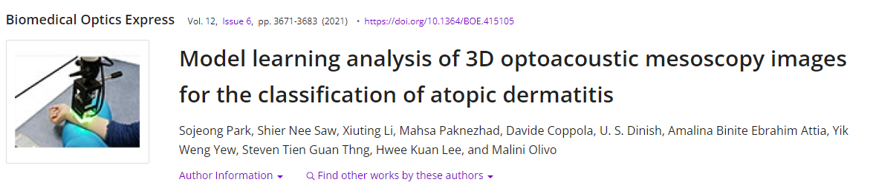
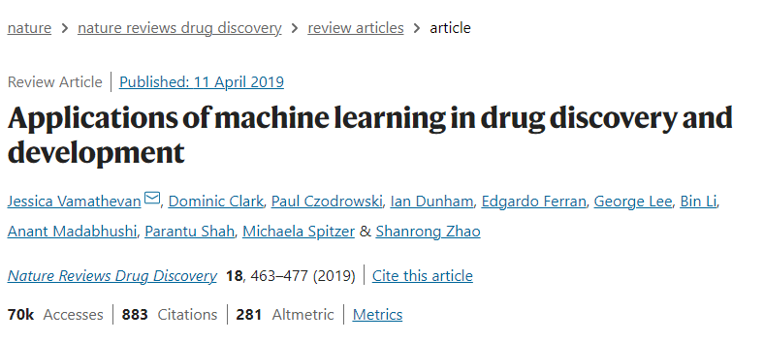
Some AI studies

Slide 11

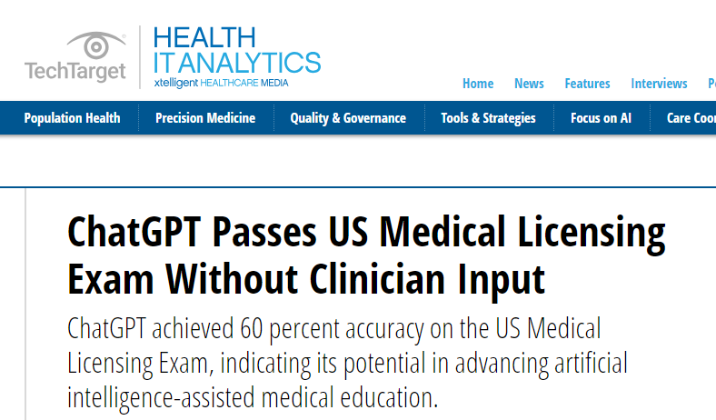
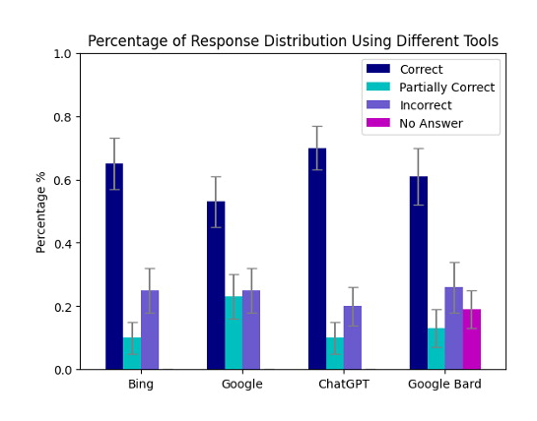
ChatGPT
Neither ChatGPT nor Google Bard, Bing and Google search engines answered all questions correctly and with 100% consistency.
Source: https://pubs.rsna.org/doi/10.1148/radiol.230922

Slide 12
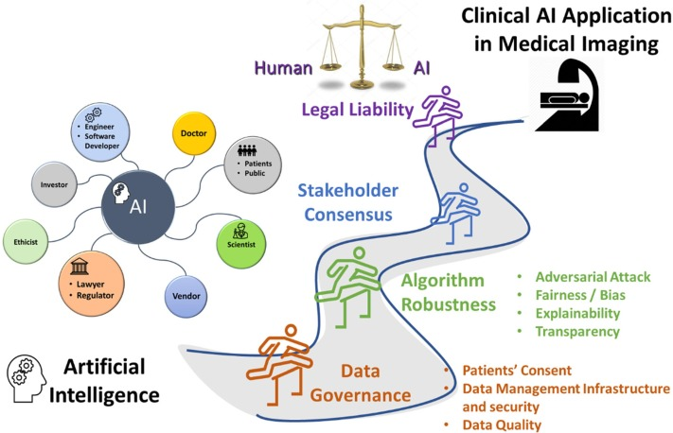
Challenges of implementing AI in Hospital
Source: https://www.sciencedirect.com/science/article/pii/S1120179722019962

Slide 13
How do we learn?

Slide 14

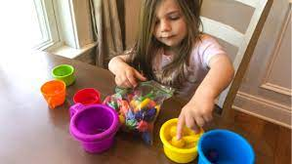

How do we learn?
Learning
Input
- Experience / Data
Output
- Task (Recognize color)
Test their performance – Quiz / Exam

Slide 15

How we train machine to learn?
Learning
Input
- Experience / Data
Output
- Task (Recognize color)
Test model performance – Accuracy, F1 score, MSE, …

Slide 16
What happen to human intelligence if
Input
Output
Unclear input
Unclear output
Precise Input
Precise output

Slide 17
Same thing happen in machine
Input
Output
GIGO
Unclear input
Unclear output
Garbish In Garbish Out
Precise Input
Precise output

Slide 18
Hands-on Collab
Introduction to Collab

Slide 19
Artificial Intelligence Techniques
Supervised Learning
Reinforcement Learning
Unsupervised Learning
Discover patterns in the data that relate data attributes with a target (class) attribute.
The data have no target attribute.
Interacts with environment, decide action, learns by trial and error method

Slide 20
Supervised Learning
is a machine learning paradigm for problems where the available data consists of labeled examples, meaning that each data point contains features (covariates) and an associated label.
Goal of supervised learning algorithms is learning a function that maps feature vectors (inputs) to labels (output), based on example input-output pairs.

Slide 21
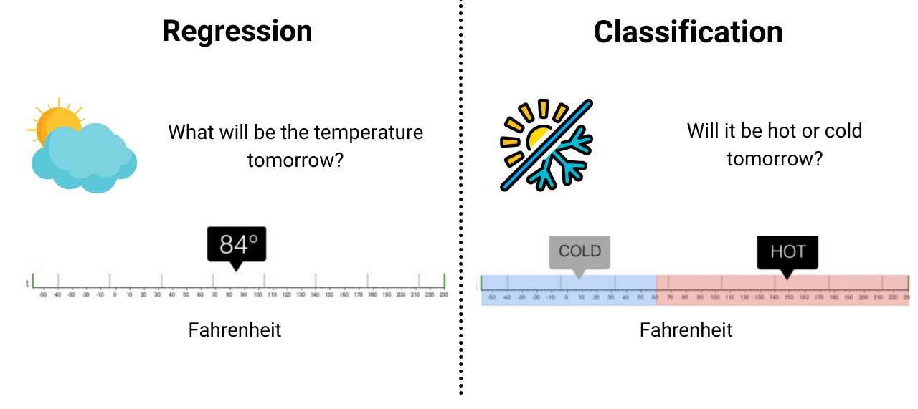
Supervised Learning
Continuous Variable
Categorical Variable

Slide 22
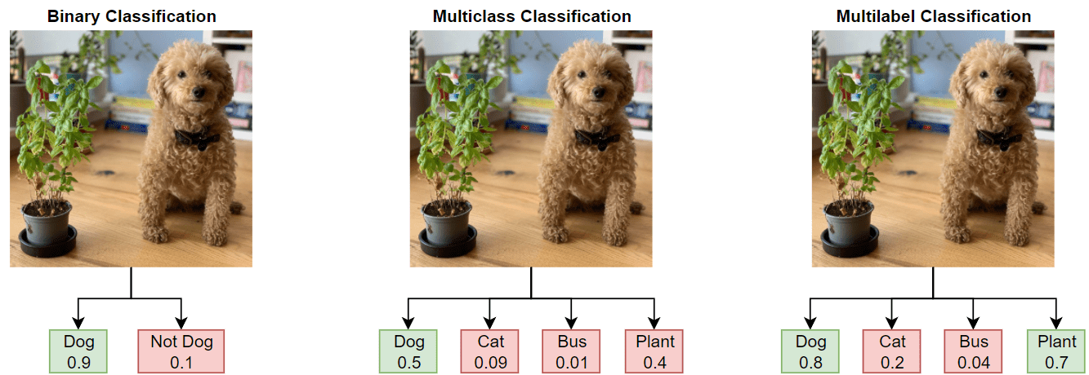
Type of Classification Problems
Source: https://www.mathworks.com/help/deeplearning/ug/multilabel-image-classification-using-deep-learning.html
Notes:
Multiclass classification assigns each instance to a single class label from a set of mutually exclusive classes.
Multilabel classification allows each instance to have multiple class labels simultaneously, and the presence or absence of each label is predicted independently.
It's important to note that the choice between multiclass and multilabel classification depends on the problem and the nature of the data you're working with.

Slide 23
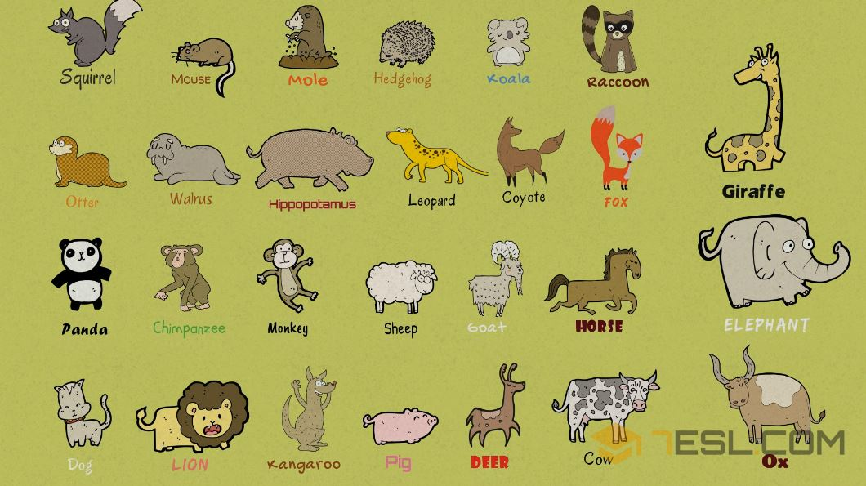
Group Activity (30min)
You are given the following animals
Group them into two groups. State the reasoning why you group them into these two groups.

Slide 24
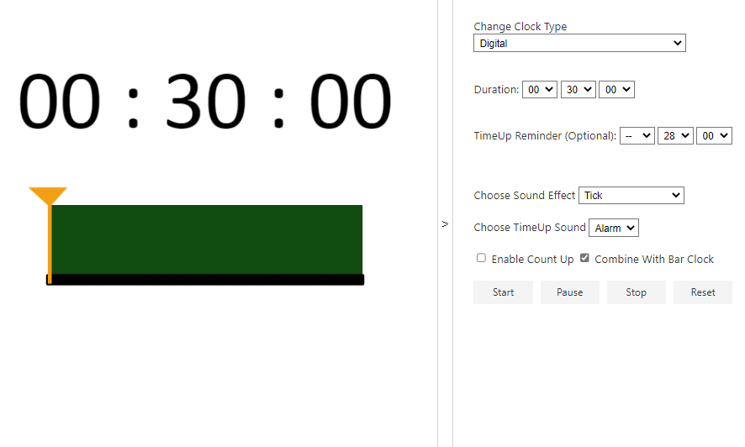

Slide 25
Features and labels
The following terms are used interchangeably:
Row, observation, datapoint, instance
Column, attribute, feature
Target attribute, target, label
A target attribute is one we are interested in predicting

Slide 26
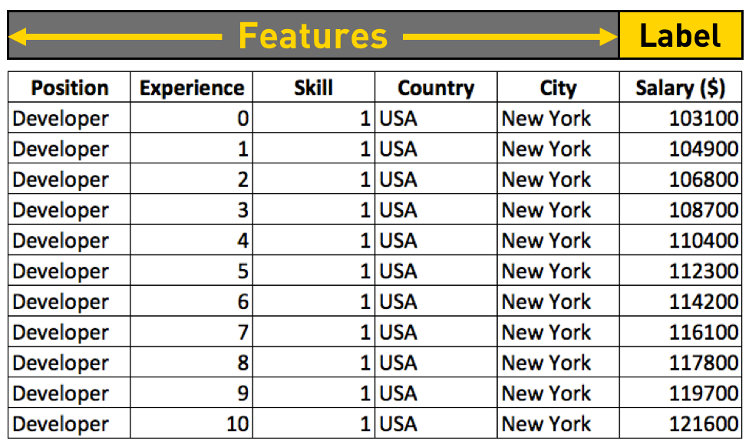
Features and Labels
Tabular Data

Slide 27
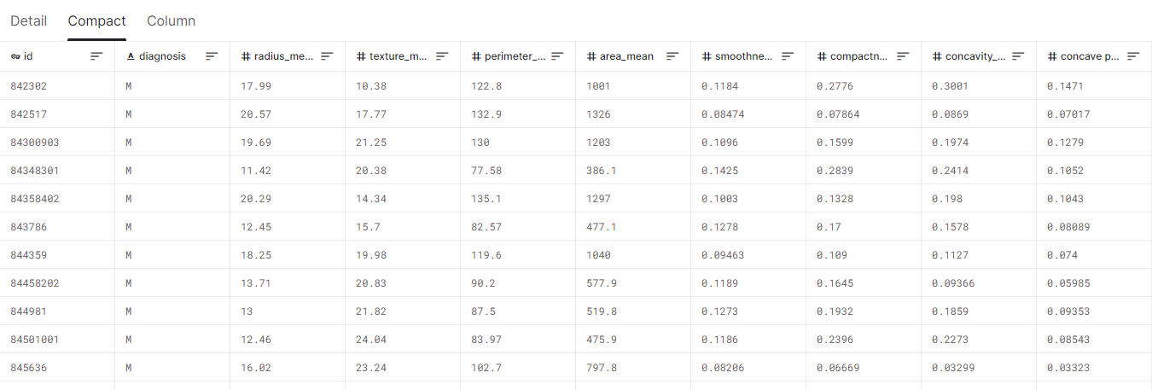
Features and Labels
Tabular Data – Breast cancer datasets
Features
Label
Source: https://www.kaggle.com/datasets/uciml/breast-cancer-wisconsin-data

Slide 28
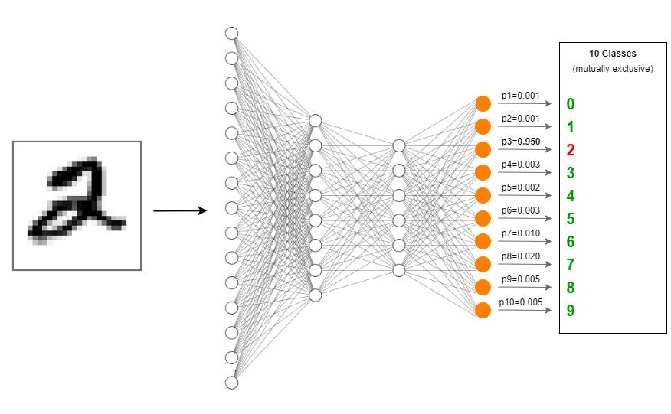
Features and Labels
Image Data
Label
Extracted Feature by D-CNN
Source: https://towardsdatascience.com/creating-a-multilayer-perceptron-mlp-classifier-model-to-identify-handwritten-digits-9bac1b16fe10

Slide 29
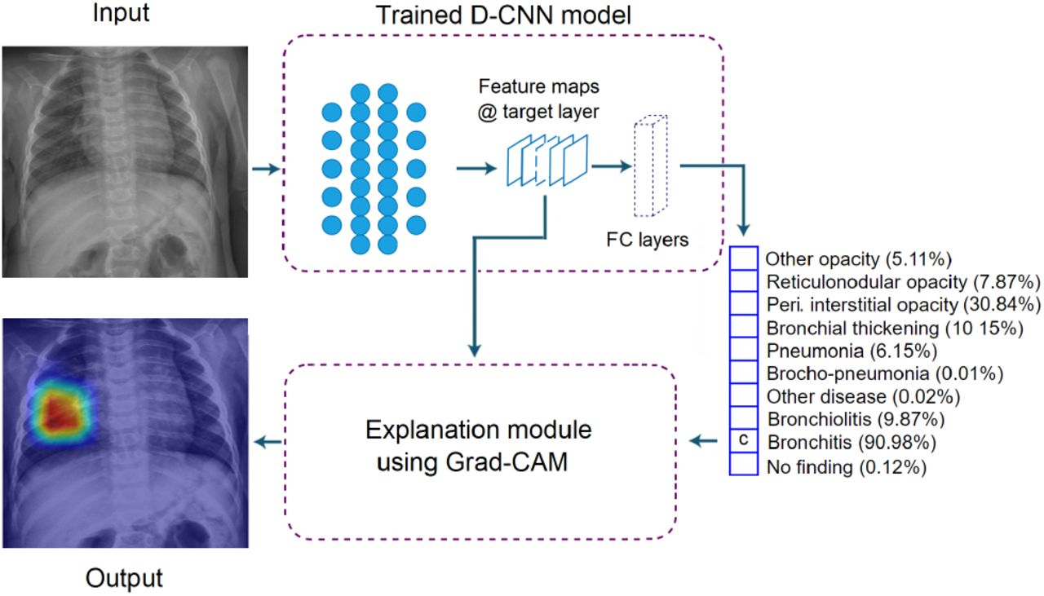
Features and Labels
Image Data
Extracted Feature by D-CNN
Label
Source: https://www.medrxiv.org/content/10.1101/2021.08.12.21261954v1.full

Slide 30
Number of Samples Needed
It depends! No one knows.
The complexity of the problem, nominally the unknown underlying function that best relates your input variables to the output variable.
The complexity of the learning algorithm, nominally the algorithm used to inductively learn the unknown underlying mapping function from specific examples.
A starting point:
Number of samples = Number of class * 1000
Number of samples = Number of features * 10 for machine learning
Number of samples = Number of weights * 50 for Artificial Neural Network [1]
[1] Alwosheel, A., van Cranenburgh, S., & Chorus, C. G. (2018). Is your dataset big enough? Sample size requirements when using artificial neural networks for discrete choice analysis. Journal of choice modelling, 28, 167-182.

Slide 31
Data Splitting
Training Data
Test Data
70%
30%
Train
Model
Test
In medical, it is important to do patient-level split to avoid data leakage.

Slide 32
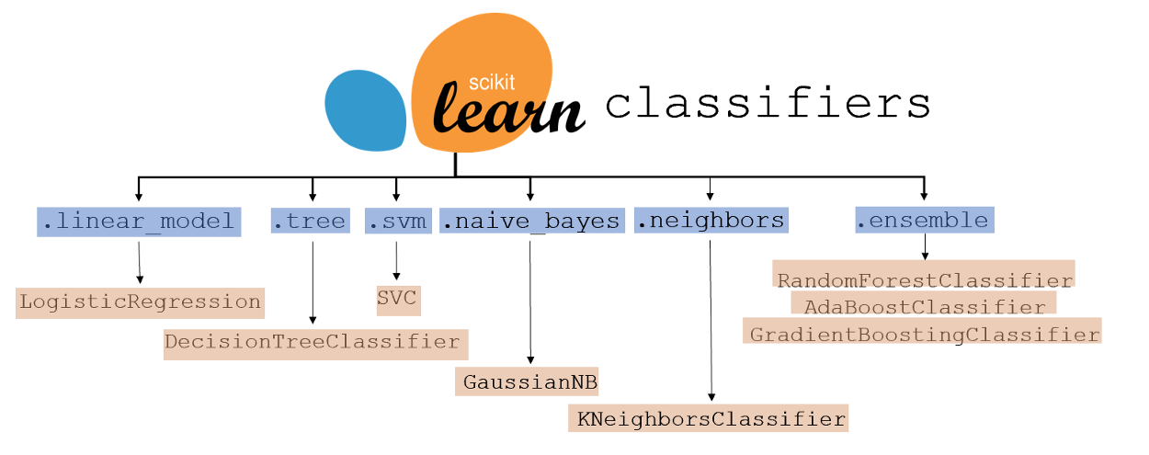

Classifiers Model
Machine Learning
Deep Learning
Convolutional Neural Network

Slide 33
Data Splitting
Training Data
Testing Data

Slide 34
Classifiers Evaluation
Training Data
Prediction
M
M
M
M
M
M
M
M
M
M
Testing Data

Slide 35
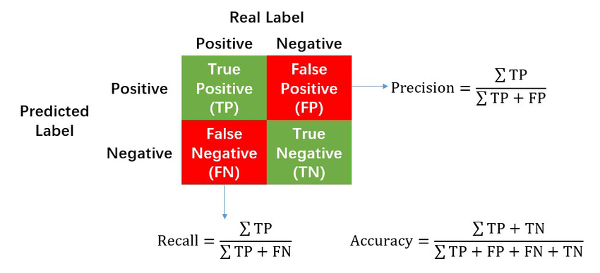
Classifiers Evaluation Metrics
Confusion Matrix
https://en.wikipedia.org/wiki/Confusion_matrix
Notes:
There are also other evaluation metrics. The most commonly used metric in classification is the confusion matrix.

Slide 36
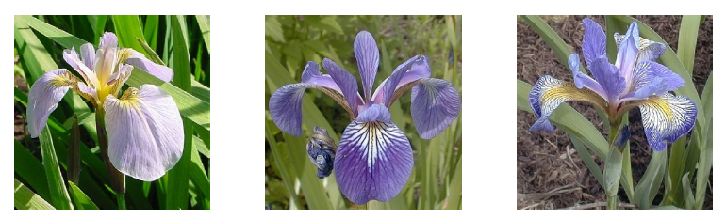
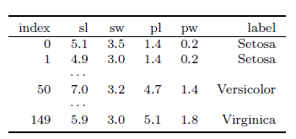

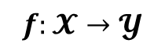


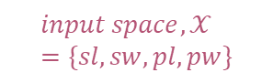
Example:
Input
Output
$$input space,𝒳=\{sl, sw, pl, pw\}$$
$$𝓨$$
$$𝓨$$
$$f:𝓧→𝓨$$
$$input space,𝒳=numeric features$$

Slide 37
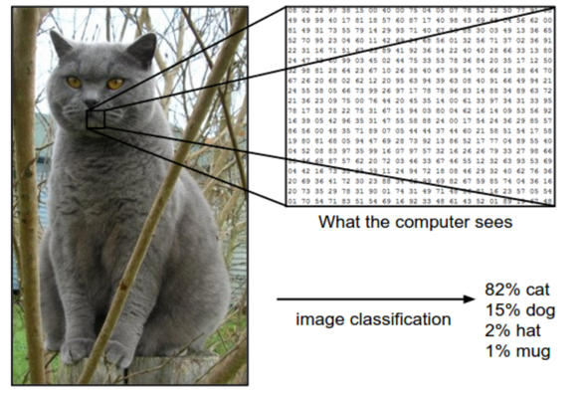
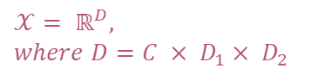

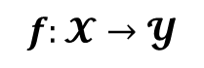
Example:
Input
Output
$$𝓨$$
$$𝒳= ℝ^{D}, where D=C × D_{1}× D_{2}$$
$$𝓨$$
$$f:𝓧→𝓨$$
$$input space,𝒳=sets of images$$

Slide 38
Hands-on Collab
Classification

Slide 39

Additional Reading
Your First Machine Learning Project in Python Step-By-Step https://machinelearningmastery.com/machine-learning-in-python-step-by-step/
4 Types of Classification Tasks in Machine Learning https://machinelearningmastery.com/types-of-classification-in-machine-learning/
Machine Learning Classifiers https://towardsdatascience.com/machine-learning-classifiers-a5cc4e1b0623
Save and Load Machine Learning Models in Python with scikit-learn https://machinelearningmastery.com/save-load-machine-learning-models-python-scikit-learn/

Slide 40
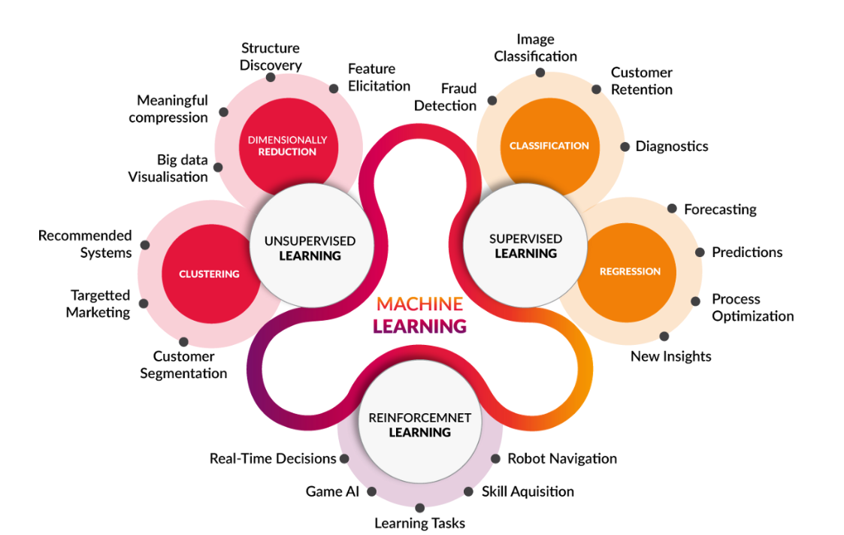
Machine Learning
https://medium.com/@yadavdeepika729/different-machine-learning-models-2387575e64cd

Slide 41
Regression
y
Process of estimating the relationship between a dependent variable and independent variables.
x

Slide 42

Regression
Pause and think about some possible example on regression problem.
https://www.springboard.com/blog/data-science/regression-vs-classification/

Slide 43
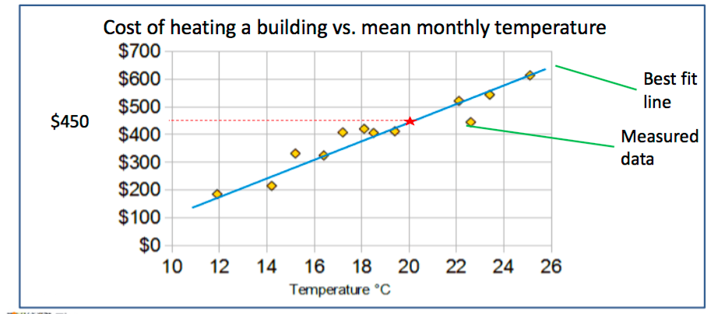
Regression
Regression predicts a target attribute which is a number (as opposed to a category)
The simplest regression is a best fit line

Slide 44
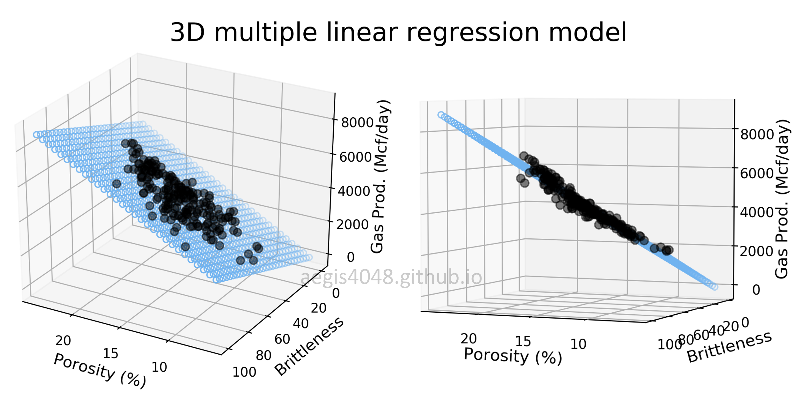
Regression
https://aegis4048.github.io/mutiple_linear_regression_and_visualization_in_python

Slide 45
Group Activity (30min)
You are given the following data.
Analyze and evaluate the data based on prediction and actual.
Create a week of weather forecast based on the sheet given.
Explain in a group.
Day | Temperature | Windy | Prediction | Actual
1 | Hot | Yes | No | No
2 | Cold | Yes | Yes | Yes
3 | Hot | No | No | No
4 | Hot | No | No | No
5 | Cold | No | No | Yes
6 | Cold | Yes | Yes | Yes
7 | Hot | No | No | No

Slide 46


Slide 47
Regression – Developing ML model
Data Preparation
Data Splitting (Train/Test)
Model Training
Model Evaluation
Data | Feature1 | Feature2 | Prediction | Temp.
Data1 | 23 | 3 |  | 32
Data2 | 12 | 51 |  | 29
Data3 | 1 | 12 |  | 24
… | … | … |  | …
DataN | 15 | 65 |  | 38

Slide 48
Regression – Developing ML model
Data Preparation
Data Splitting (Train/Test)
Model Training
Model Evaluation
Data | Feature1 | Feature2 | Prediction | Temp.
Data1 | 23 | 3 |  | 32
Data2 | 12 | 51 |  | 29
Data3 | 1 | 12 |  | 24
… | … | … |  | …
DataN | 15 | 65 |  | 38
70%
Training
30%
Test

Slide 49
Regression – Developing ML model
Data Preparation
Data Splitting (Train/Test)
Model Training
Model Evaluation
Use only training data to train the model
Data | Feature1 | Feature2 | Prediction | Temp.
Data1 | 23 | 3 |  | 32
Data2 | 12 | 51 |  | 29
Data3 | 1 | 12 |  | 24
… | … | … |  | …
DataN | 15 | 65 |  | 38
70%
Training

Slide 50
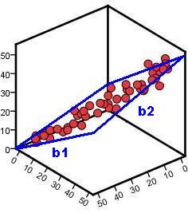
Regression – Developing ML model
Data Preparation
Data Splitting (Train/Test)
Model Training
Model Evaluation
Example of linear regression
Temperature
Feature 1
Feature 2

Slide 51
ML Model – Regression Evaluation Metrics
Data Preparation
Data Splitting (Train/Test)
Model Training
Model Evaluation
Use only testing data to evaluate the model
Data | Feature1 | Feature2 | Prediction | Label
Data1 | 23 | 3 | Cold | Cold
Data2 | 12 | 51 | Cold | Hot
Data3 | 1 | 12 | Hot | Hot
… | … | … | … | …
DataN | 15 | 65 | Hot | Cold
30%
Test
https://en.wikipedia.org/wiki/Confusion_matrix

Slide 52
ML Model – Regression Evaluation Metrics
Data Preparation
Data Splitting (Train/Test)
Model Training
Model Evaluation
A perfect model should predict all testing data correctly → Mean Square Error = 0
Data | Feature1 | Feature2 | Prediction | Label
Data1 | 23 | 3 | Cold | Cold
Data2 | 12 | 51 | Cold | Hot
Data3 | 1 | 12 | Hot | Hot
… | … | … | … | …
DataN | 15 | 65 | Hot | Cold
30%
Test

Slide 53
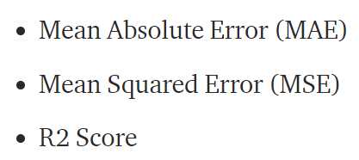
ML Model – Regression Evaluation Metrics
Data Preparation
Data Splitting (Train/Test)
Model Training
Model Evaluation
https://medium.com/@parag.jain164/performance-matrix-for-regression-model-c9ba0d2cae33

Slide 54
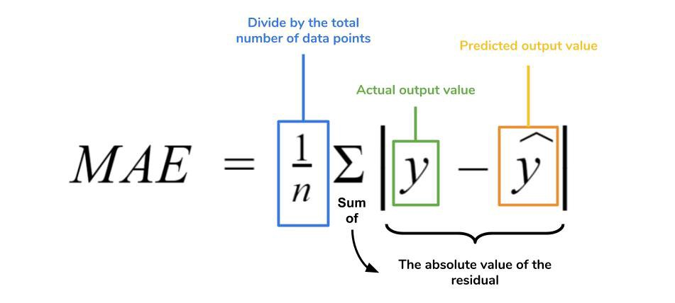
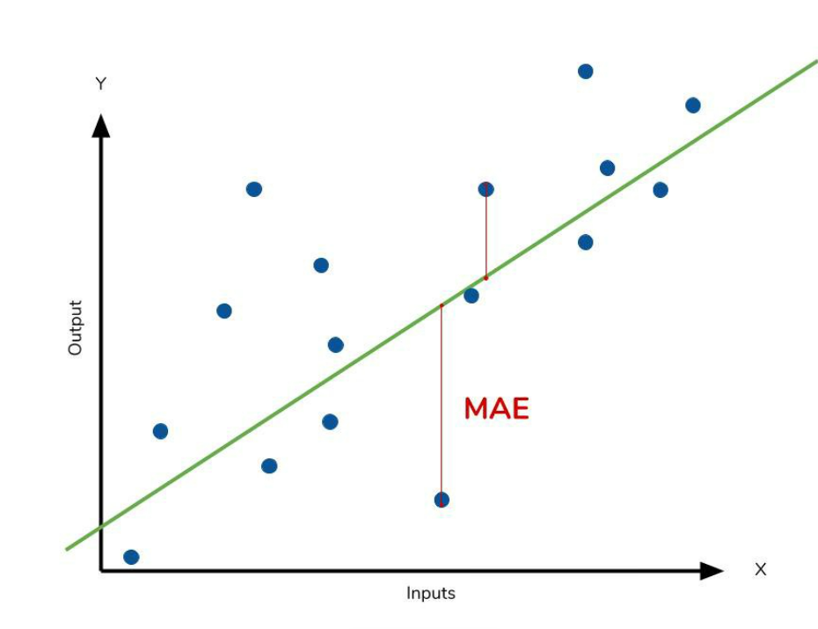
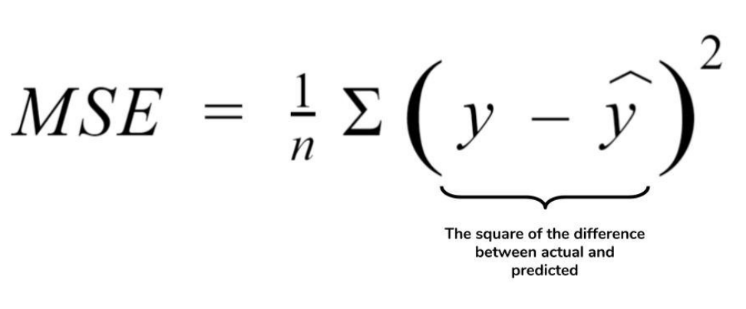
ML Model – Regression Evaluation Metrics
Data Preparation
Data Splitting (Train/Test)
Model Training
Model Evaluation
https://medium.com/ml-cheat-sheet/machine-learning-evaluation-metrics-b89b8832e275

Slide 55
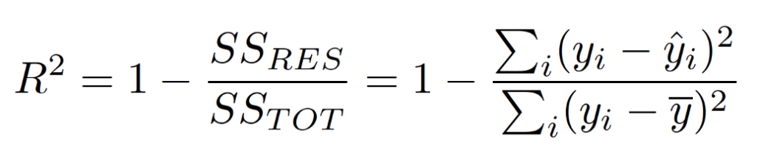
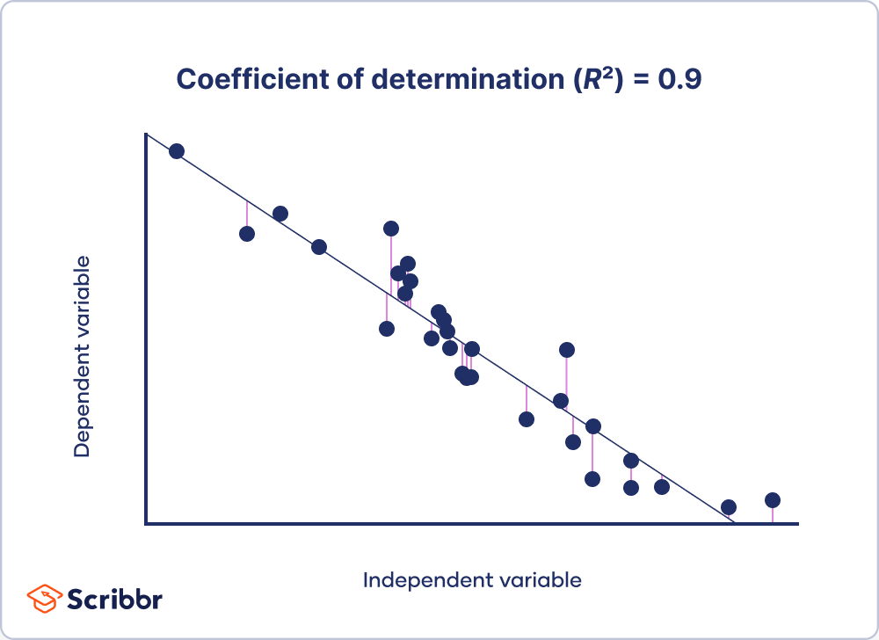
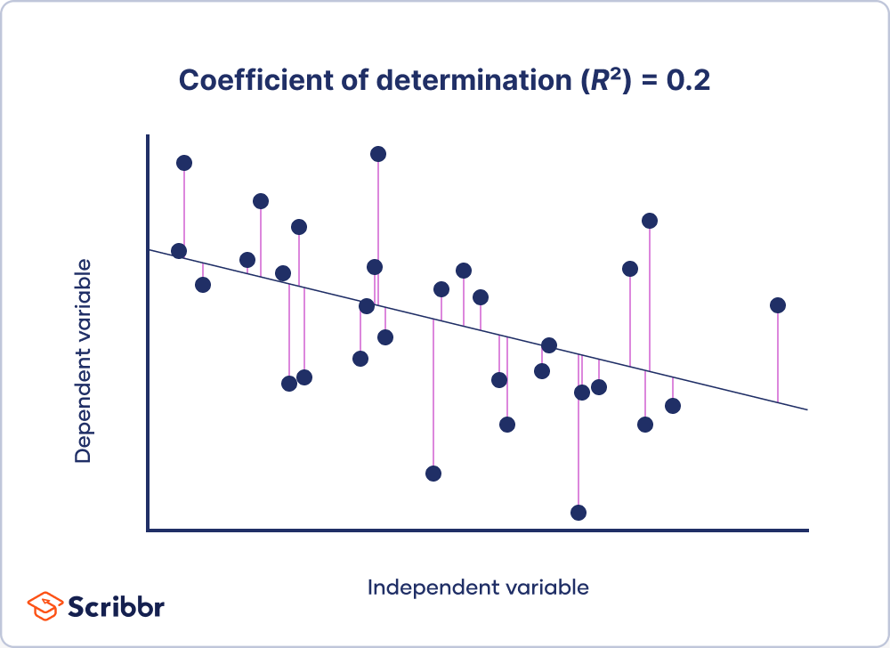
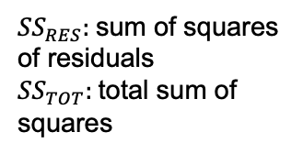
ML Model – Regression Evaluation Metrics
Data Preparation
Data Splitting (Train/Test)
Model Training
Model Evaluation
${SS}_{RES}:$sum of squares of residuals
${SS}_{TOT}:$total sum of squares
https://www.scribbr.com/statistics/coefficient-of-determination/

Slide 56
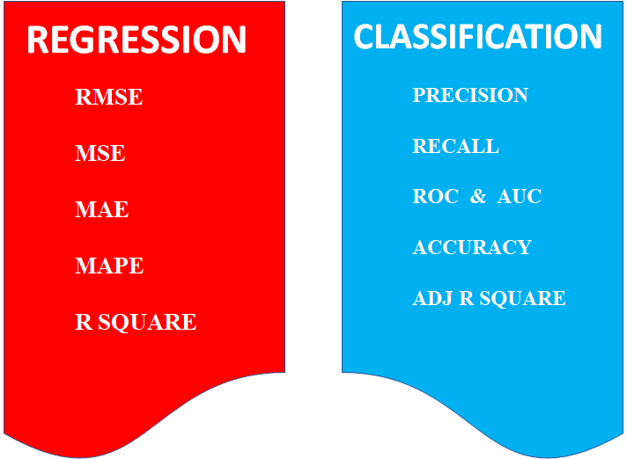
ML Model – Evaluation Metrics
https://medium.com/odscjournal/are-we-choosing-the-right-evaluation-metrics-how-to-choose-it-ee01fcf34b9

Slide 57
Corresponding Code
Data Preparation
Data Splitting (Train/Test)
Model Training
Model Evaluation
pd.read_csv()
sklearn.model_selection.train_test_split()
model.fit()
model.predict()

Slide 58
Hands-on Collab
Regression

Slide 59
Kahoot!
https://create.kahoot.it/details/4c466fc3-6327-4818-8174-064b298784ee

Slide 60
Summary
Classification → predict categorical variable
Regression → predict continuous variable
Machine Learning Process
Data Preparation
Data Split
Model Training
Model Evaluation

Slide 61
Additional Reading
Scikit-learn Linear Regression documentation
https://scikit-learn.org/stable/modules/generated/sklearn.linear_model.LinearRegression.html
Hands-on exercise on linear regression
https://colab.research.google.com/github/csmastersUH/data_analysis_with_python_2020/blob/master/linear_regression.ipynb

